Slide 1
Sharpy Install Guide

Slide 2
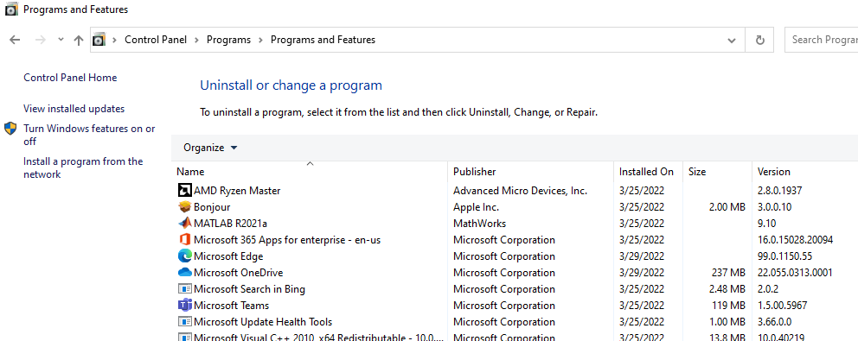
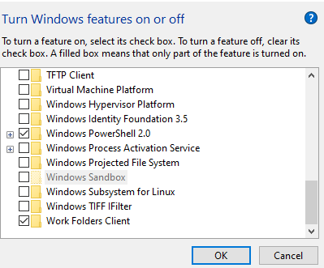
Windows Settings

Slide 3

Install Ubuntu

Slide 4
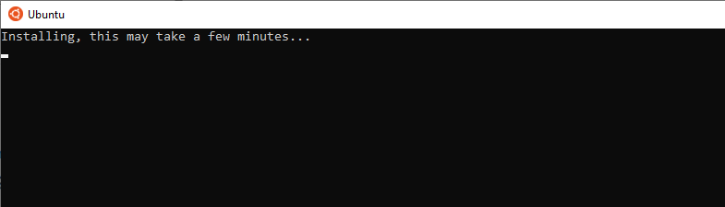
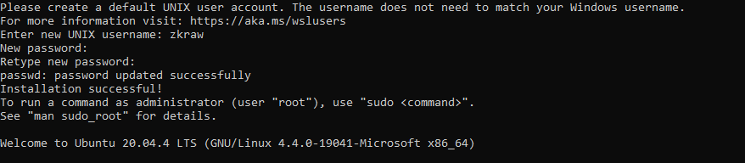
Load Up Ubuntu
Give a username and password after the install is complete

Slide 5
Load Up Ubuntu
Give a username and password after the install is complete

Slide 6
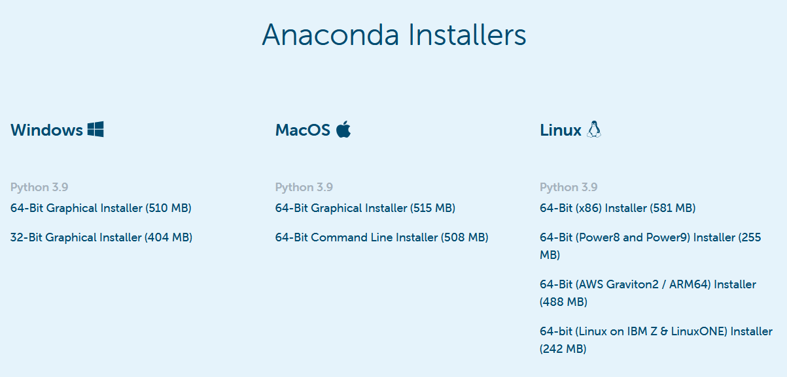
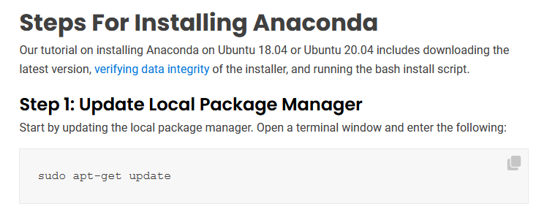

Install Anaconda
Step 2: Go to the Downloads directory in Linux by using similar syntax
Step 4: Say yes to every prompt and install in complete
Step 3: Run bash command to begin install process of Anaconda

Slide 7






Install GCC and gFortran
GCC
gFortran
Close the terminal, then verify that all of these commands return a version of software

Slide 8
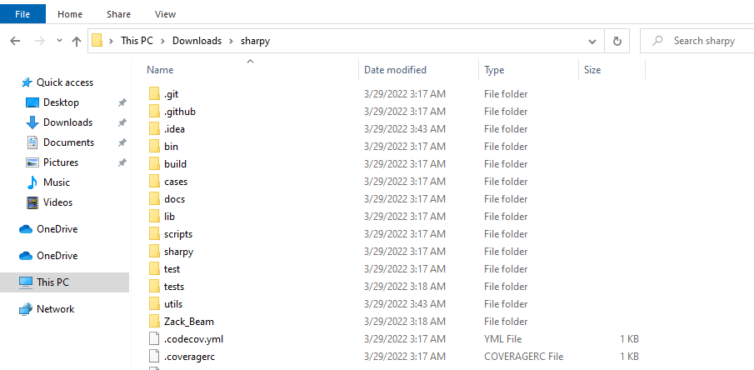

Sharpy Install
Download and extract sharpy to folder of your choice
Navigate to the folder where you placed sharpy. In this example, it is in my Downloads folder
Delete the build folder
Go into the Sharpy folder with the following commands and create the conda env

Slide 9



Sharpy Install
After deleting the old build folder, make a new one and then go into it
Ensure that the SHARPy environment is activated
While in the build folder run cmake ..
Run the make command to compile the fortran code
Install of Sharpy is complete!

